Slide 1
Multi-Modal Modeling of Compound Bioactivity: A
Comparative Study of Regression and Classification
Approaches
Dennis Mathew Jose & Vamsinath Thatha
IE7275 Data Mining in Engineering –25 Spring
Dennis Jose | jose.de@northeastern.edu Vamsinath Thatha | thatha.v@northeastern.edu

Slide 2
Problem Overview
Why predict compound bioactivity?
Drug discovery is costly, time-consuming, and inefficient with high failure rates in clinical trials.
Traditional high-throughput screening lacks efficiency; ML offers a scalable solution
pIC50 is a standardized metric representing compound potency; higher values indicate greater activity and a potential drug-candidate for further testing
ML based prediction supports early-stage filtering to reduce R&D costs and improve therapeutic success.

Slide 3
Data Description
ChEMBL: A Rich Resource for Drug Discovery
Source: ChEMBL Database ( 2M+ compounds, 15,000+ targets )
Dataset sample: 10,000 rows ~17 columns
Feature Types:
Physicochemical descriptor: MolWt, LogP, TPSA
Structural data: SMILES, Morgan Fingerprints
Target info: target_chembl_id, target_family
Bioactivity: IC50, pIC50 ( target variable )
Integration of structural + biological + chemical info supports robust prediction

Slide 4
Preprocessing & Feature Engineering
From Raw to Refined Data
Cleaning:
Dropped columns: organism ( 100% missing )
Rows with missing SMILES dropped; minimal missing data elsewhere
Imputation: Median for numerics, Mode for categoricals
Feature Engineering:
New descriptors (e.g: NumRings from SMILES)
Morgan fingerprints (512-bit) post-baseline modeling
Multicollinearity handling: Used VIF instead of PCA to preserve interpretability
Removed features like num_h_donors ( high VIF, low importance )

Slide 5
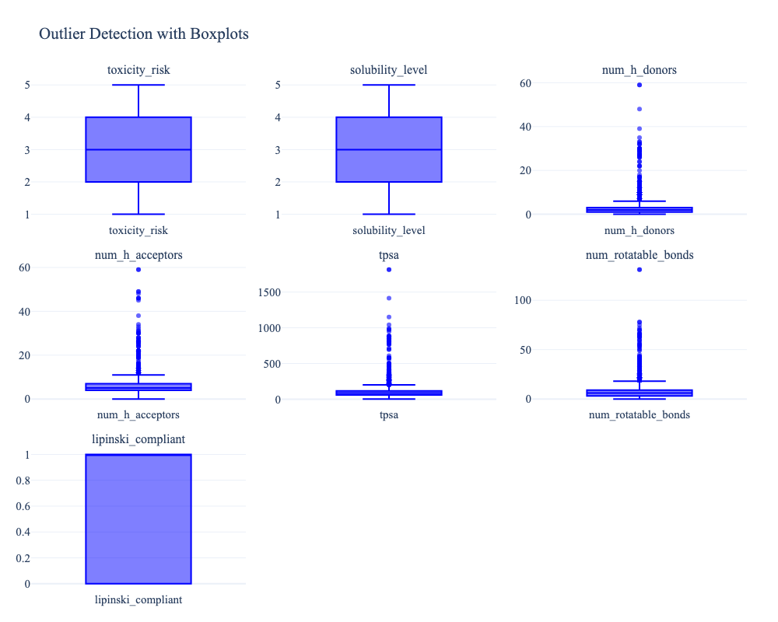
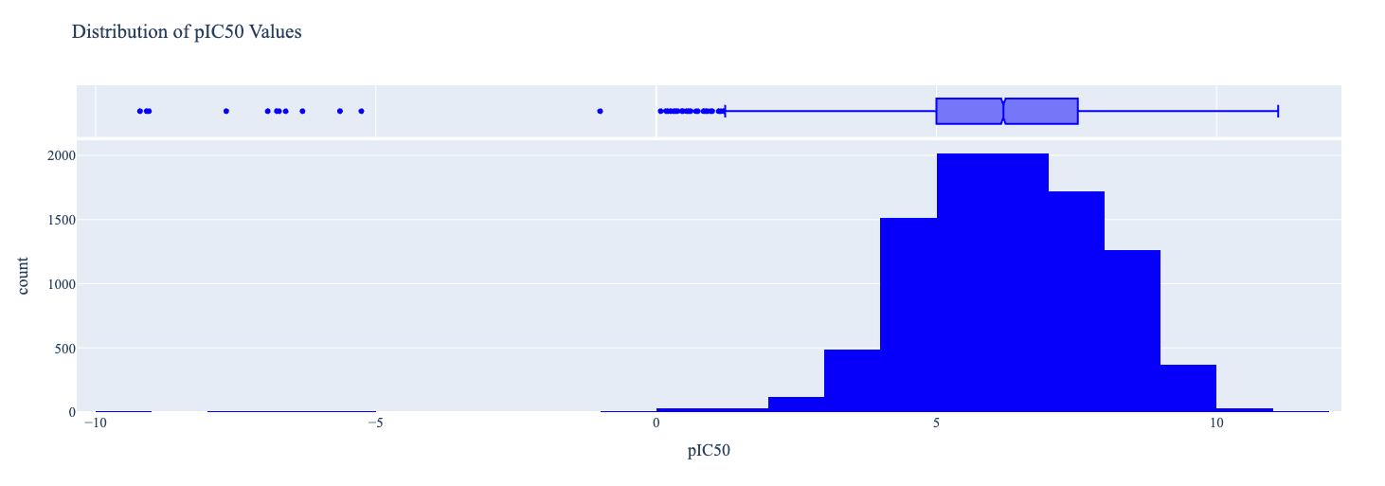
Exploratory Insights
pIC50 Distribution
Outliers in Molecular Features
Right Skewed with outliers; Cleaned to remove negative outliers
Skew in TPSA, rotatable bonds, H-bond donors/acceptors
Retained extreme values due to potential chemical significance

Slide 6
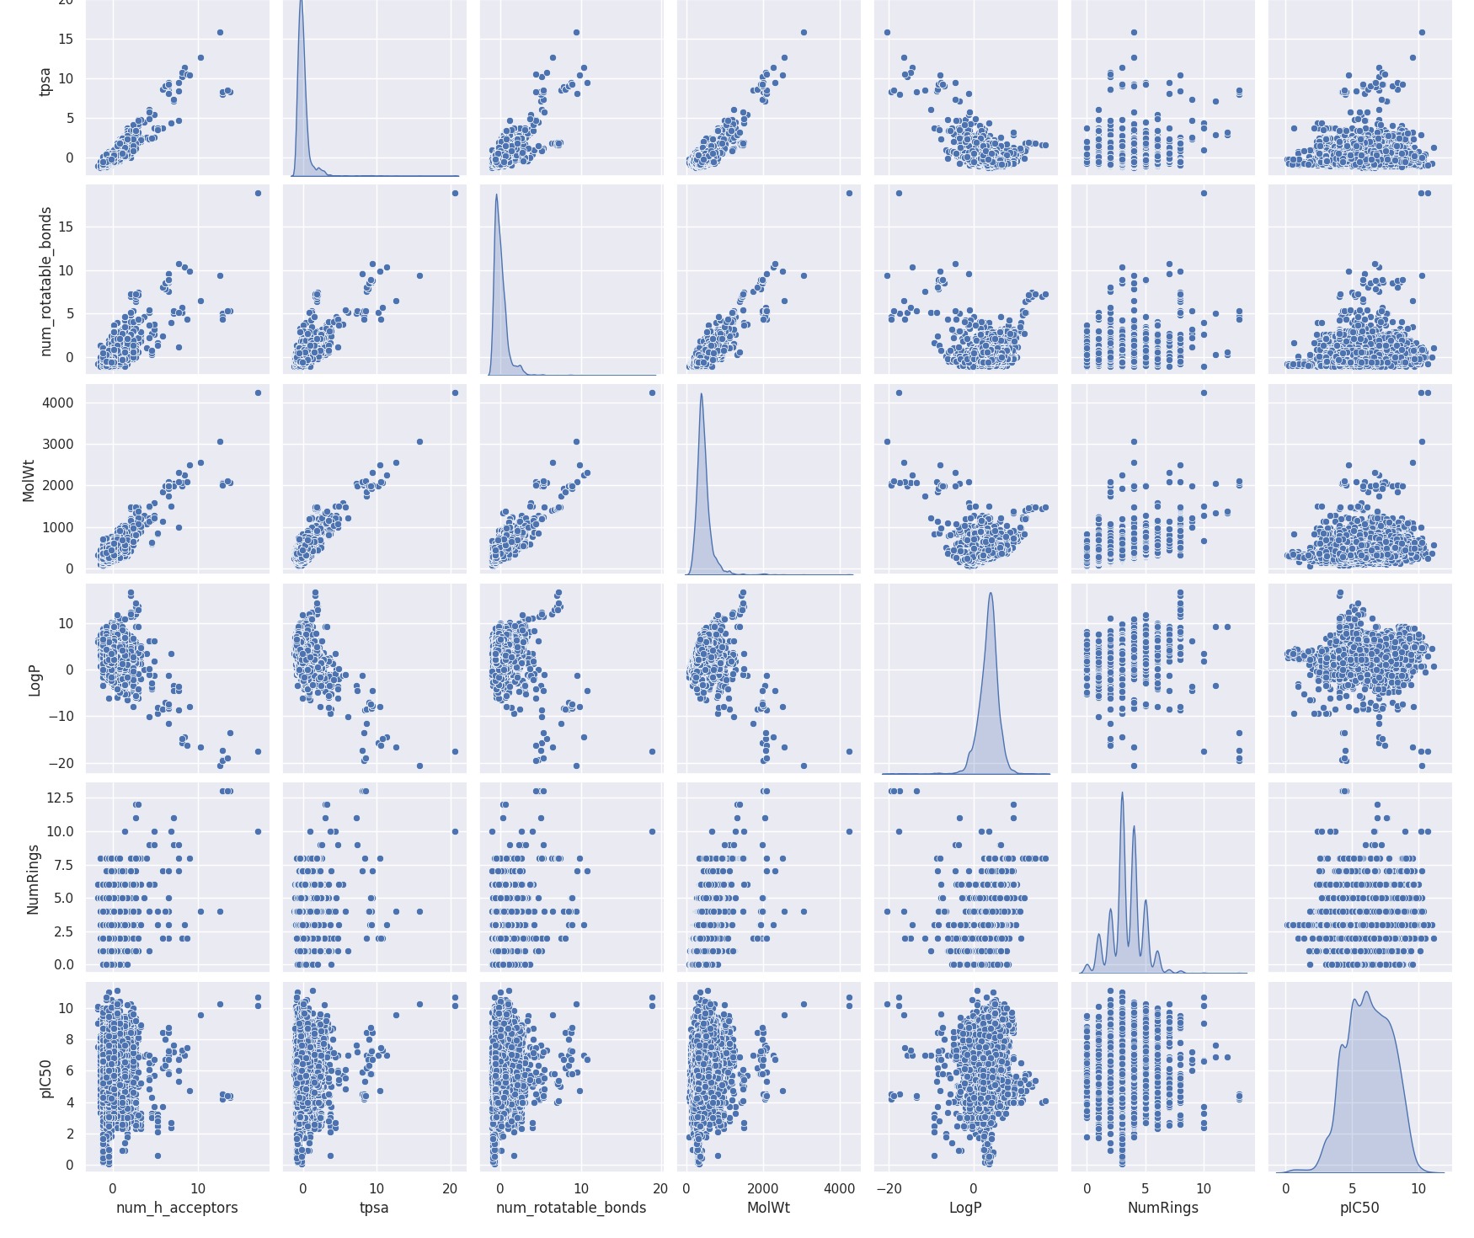
Exploratory Insights
Pair plot observations
Most features follow drug-likeness rules- Lipinski's Rule of 5
Molecular weight <= 500 Daltons
LogP <= 5 ( how easily it dissolves in fat vs. Water)
No More than 5 hydrogen bond donors
No more than 10 hydrogen bond acceptors
No strong correlation was observed between any single molecular descriptor and pIC50.
This confirms that bioactivity is multi-factorial – it arises from complex interaction between multiple features

Slide 7
Modeling Approach
From Molecule to Model
Pipeline
Data split: 80% train/validaion, 10% final test set
Standardization + Label Encoding
Baseline modeling with Ridge, Random Forest, MLP and XGBoost
Tuning via GridSearchCV
Feature Augmentation with Morgan fingerprints
Two Tasks
Regression: Predict pIC50
Classification: Predict active (pIC50 >= 6) vs Inactive ( for real-world decision making )

Slide 8
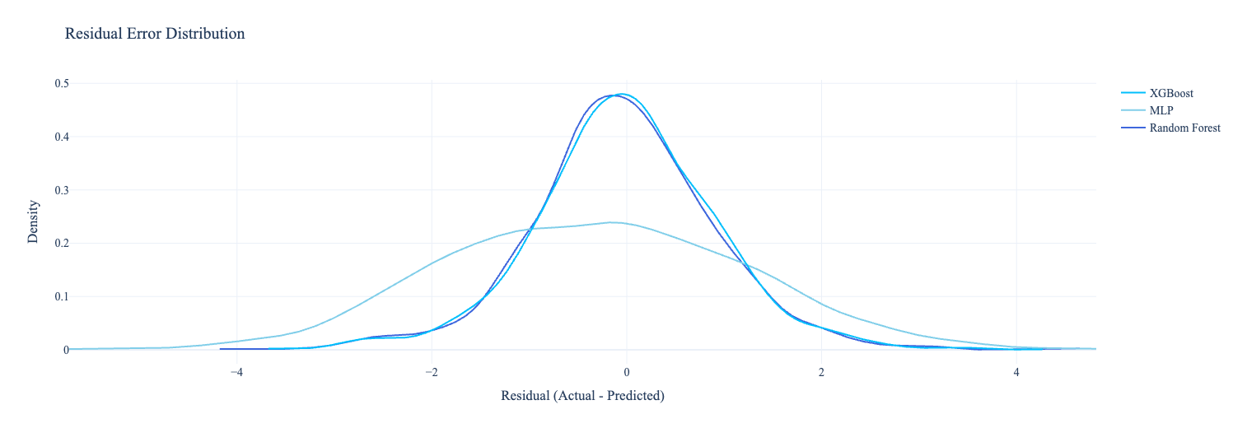
Model Performance & Comparison
Which model performed best in predicting?
Performance Evaluation - Regression
Top Performer: XGBoost Regressor
R-square: 0.963 (Training Set)
RMSE: 0.83 (Test Evaluation )
MAE: 0.60 ( Test Evaluation )
The addition of morgan fingerprints significantly improved model performance by capturing fine-grained chemical substructures.
Tree based ensemble models best capture complex non-linear bioactivity patterns
Model | RMSE | MAE
Ridge Regression | 1.2535 | 0.9916
Random Forest | 0.8523 | 0.6226
MLP | 1.0265 | 0.7535
XGBoost | 0.8299 | 0.6037

Slide 9
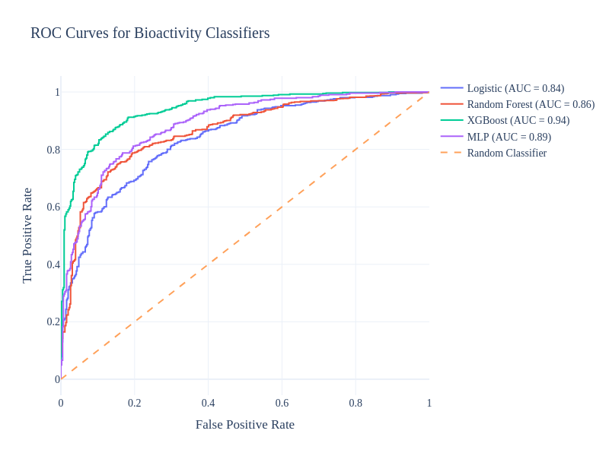
Model Performance & Comparison
Which model performed best in classifying?
Performance Evaluation - Classification
Model | F1-Score | ROC AUC | Sensitivity
Logistic Regression | 0.77 | 0.85 | 0.77
Random Forest | 0.77 | 0.87 | 0.78
MLP | 0.81 | 0.89 | 0.81
XGBoost | 0.86 | 0.94 | 0.86
Top Performer: XGboost Classifier
XGBoost has the lowest Cost-Benefit Ratio : 0.0833
Effectively minimizes the false Negatives, which are costly in drug screening
XGBoost is not just the accurate, but also the most cost-effective for compound prioritization

Slide 10
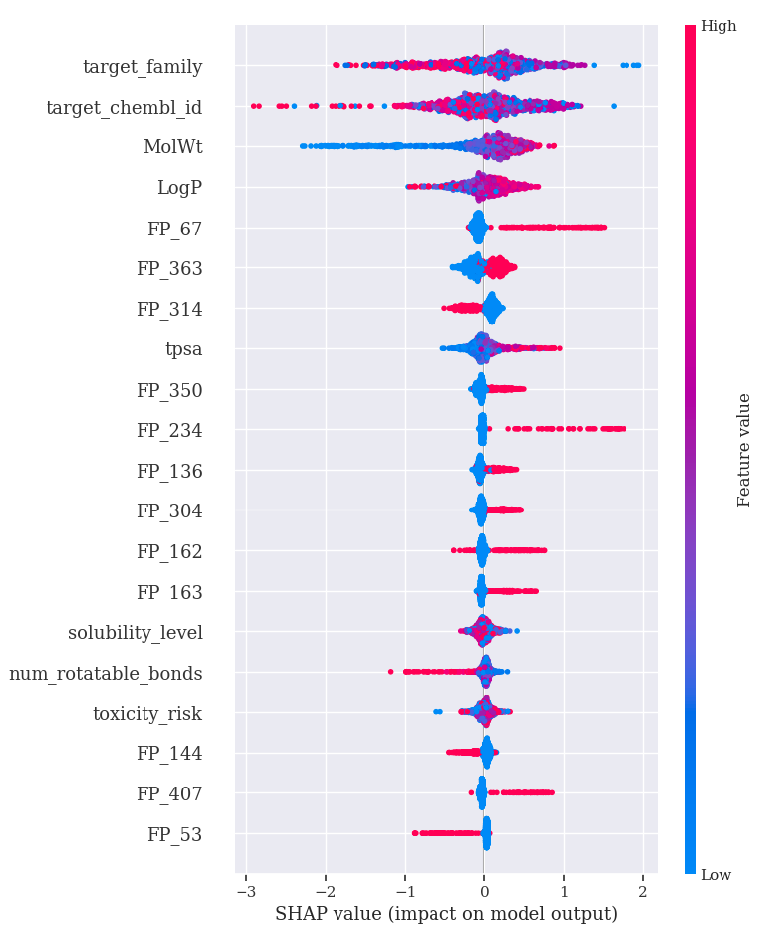
Feature Importance / Interpretability
What Matters Most?
The model's decisions are guided by a combination of target-specific identifiers, broad chemical descriptors and fine-grained structural subpatterns.
Fingerprints like FP_67, FP_314, and FP_363, alongside classic descriptors like MolWt and LogP play a key role in predicting the compound bioactivity.
The model has learned that, in general, higher molecular weight compounds are more likely to be active, while lighter compounds are more likely to be inactive, and it uses this pattern to make predictions.
Features don't act alone; the interaction of high and low values across features determines the final prediction

Slide 11
Conclusion & Takeaways
Lessons from Molecules
ML, especially XGBoost, effectively predicts compound bioactivity with interpretable results
Adding morgan fingerprints boosts model accuracy and insight
Classification aligns better with real-world screening – binary decisions aid compound triage
Limitations
Overfitting risks with high-dimensional data
Scaffold leakage may inflate performance
No accounting for toxicity/off-target effects
Next Steps
Scaffold-split validation
Extend to multi-task Learning (e.g: Toxicity & Solubility prediction) - can improve learning efficiency and help develop safer, more drug-like candidate by balancing efficacy with developability
Evaluate on external benchmark datasets – Validate the model using independent datasets (not from ChEMBL) to assess its robustness and generalizability

